Slide 1
Expansion & Renovations to
Thomas Memorial Library
August 11, 2014
6 Scott Dyer Road
Cape Elizabeth, Maine 04107
Owner: Town of Cape Elizabeth
Architect: Reed & Co. Architecture
TML Library Building Committee:
Molly MacAuslan, Chair, Town Council
Katharine Ray, Town Council
Frank Governali, Committee Member
Martha Palmer, TML Trustee
Jeff Shedd, CEHS Principal
Kelly Hasson, Pond Cove Principal
Mary Kate Williams-Hewitt, School Board
Greg Marles, CE Director of Facilities &
Transportation
Jay Scherma, CE Library Director

Slide 5
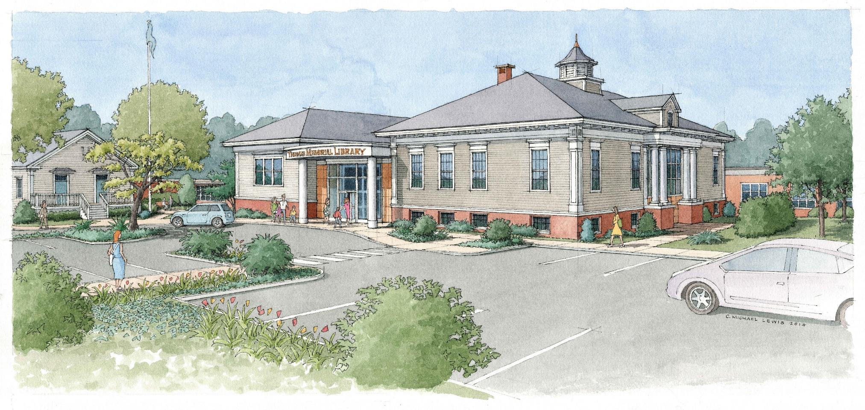

Slide 6
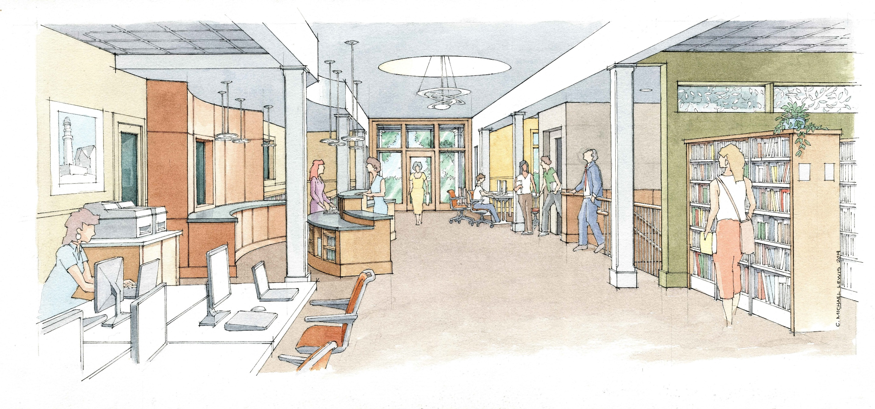

Slide 7
